Slide 1

Food Delivery Website
Task - 2

Slide 2
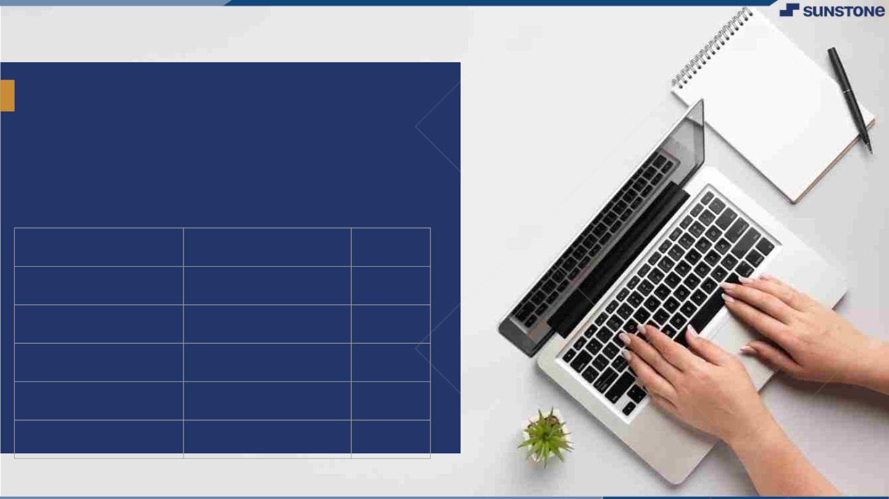
Food Delivery Website
In the fast-paced digital era, the convenience of ordering food online has become an integral part of our daily lives. Our project aims to develop a cutting-edge Food Delivery Web Application, providing users with a seamless and delightful experience for discovering, ordering, and enjoying a diverse range of culinary delights from their favorite local restaurants.
▪
LMS Username
Name
Batch
au311120205016 Bhavesh Sadhwani 14
au311120205023 Dhanush Kabilan 14
au311120205035 Luxon C L 14

Slide 3

Taskꢀ-2
Create UI and implement various components using react
●
●
●
Split design into components and Higher order Components
Define structure of the components
Set the basic ui components with dummy data
Integrate the APIs to frontend to ensure the dynamic feature of website
●
●
●
●
●
Pointbase api to the severs base url
Design api calls for each element
Handle errors in the output
Render output of apis to different low level components
Secure content of post apisx
Evaluation Metric:
● 100%Completion of the above tasks
Learning Outcome
▪
▪
▪
▪
Developing complicated UI using react components
Using props drilling and context to pass variables
Getting familiar with different type of api calls
Handling different input data

Slide 4

Component Structure:
Define the structure of each component, outlining their roles and interactions.
Establish a clear hierarchy for effective component communication.
Basic UI Components:
Set up basic UI components with placeholder or dummy data for initial rendering.
API Connection:
Point the application's API calls to the server's base URL.
Ensure seamless communication between the front-end and the back-end.
API Design:
Design API calls for each element, mapping out the required data and endpoints.
Consider modularizing API functions for maintainability.
Step-WiseDescription
Summary of your task
The project involves designing and structuring components, both regular and Higher Order Components (HOCs), for a web application. Basic UI components are set up with placeholder data, and API calls are configured to the server's base URL. The design of API calls for each element is outlined, with a focus on modularization. Robust error-handling mechanisms are implemented for API responses, and low-level components are created to render specific API outputs dynamically. Special attention is given to securing content, especially for post API calls. The work involves iterative testing, addressing errors, and ensuring a seamless deployment to a production environment. Documentation is created for future maintenance and troubleshooting.

Slide 5
Submission Github
https://github.com/Bhavesh-G-Sadhwani/NM-LICET-IT-GROUP-14/tree/main/Task%202-NM_FrontEnd_Framework_FoodDeliveryWebsite

Slide 6


